Slide 1

Wellington Farm Forestry PC1, Stream 3 Submission
Presented by Eric Cairns, Secretary Wgtn FFA
Notes:
Photo is from GW publicity as published in the Leader June 2024

Slide 2
Insufficient Stringency to override NESCF
Whilst NESCF does allow for councils to override it in order achieve objectives of NPSFM, the case is weak.
Only a few smaller pFMU currently fail TASVC (except Boulcott, under challenge)
There is no acknowledgement that bedding in NESCF along with better enforcement and improved training could also contribute to achieving VC objectives
Note that several pFMU with significant levels of Plantation Forestry actually meet TASVC
There is no substantive evidence that forestry activities are causing failure of VC at Hutt Boulcott or Makara at Kennels
Notes:
Our first position is to support the submission by NZFFA referring to insufficient Stringency

Slide 3
Fallback Choice is Controlled Consent for Forestry on potentially high erosion risk land only where TASVC fails
Potentially high-risk slopes (>26⁰) have higher risk of surficial erosion
Controlled consent will still allow GW to apply conditions that can be enforced
Consent will safeguard business and supply chain continuity
That low risk (less steep) sites are not saddled with unnecessary costs
Notes:
In the event that the commissioners reject our argument of stringency,
Surficial erosion will include forestry earthworks., but we agree with Mr Blyth, that there is a relatively low risk of shallow landslides on forestry land within these Whaitua
We say that existing best practice (as detailed in NZFOA manuals), along with adhering to NESCF conditions, provides adequate control. If conditions cannot be met, harvesting activity shouldl escalate to discretionary consent anyway
There is no need for certified Forestry Management Plans (another expense that adds little value)
For any earthwork activity, this must be backed up by site visits (including to permitted activity sites) and training. Obviously, there is cost recovery applying to monitoring permitted activity.
Consents still add a significant cost. These fees should not be charged too far in advance of available revenue.

Slide 4
Next fallback choice is supporting Restricted Discretional Consent where TASVC fails
Acknowledge that NESCF, as it currently operates, could do better
Question whether additional regulation will actually deliver sought after TASVC
This option will disproportionally affect small commercial forestry blocks
Acknowledge that Forestry interests need to be seen to improve their environmental performance
Notes:
This choice is predicated by:
water plans and review of TAS and climate change effects
In combination with training, methods 44 a, b and c
Preference that low risk activities defer to operate under NESCF (which can involve discretionary control if conditions are not met)
Consider that several SFS Class A attributes will be very hard to meet, in part because of climate change and historic widespread changes to vegetation cover (including urbanization, and impermeable surfaces)
Improved environmental performance is part of Public License to Operate, even though much of the Ecosystem Services provided by plantation forestry are invisible to the public. (avoided risk of erosion)

Slide 5
WH.R20, monitoring records and receiving water bodies
Latest monitoring point quoted
Receiving Bodies
Most recent monitoring record for VC dictates whether NESCF prevails or whether Restricted Discretionary activity applies
Restriction on activity should refer to median value over the longer term (5 yrs), not to the most recent record.
WH.P28 and S42a clearly intend that the VC status of receiving water bodies would also dictate where restricted discretionary activity was applied.
WH.R20 fails to mention receiving bodies
Notes:
WH.R20 clearly is obscure, and does clearly not reflect what should be happening.

Slide 6
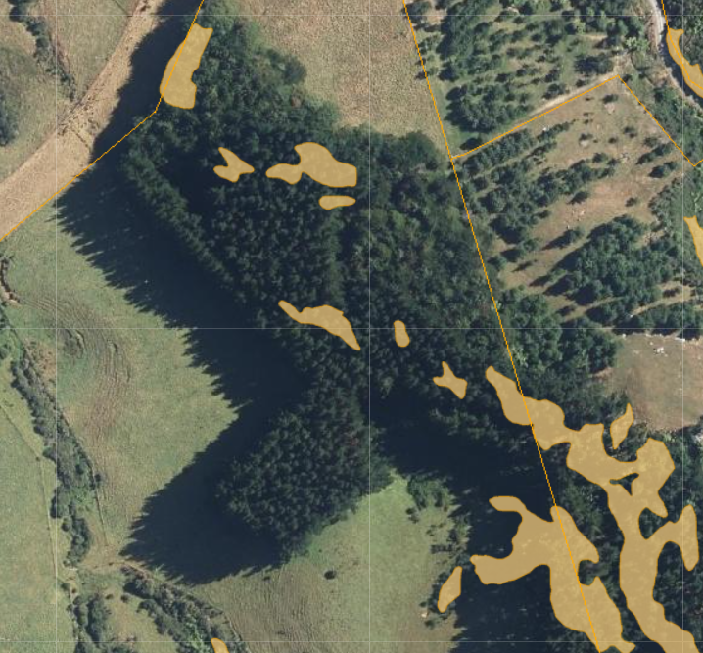
Minimum areas and low risk exemptions
Example of small block with yellow hazardous slope overlay
There are a few existing small commercial forests not on potentially steep land and not close to water bodies.
The photo here is from UHCC where hazardous slope overlay is in orange (>26⁰), Colletts Road
There will be more small woodlots on less steep land, and away from water bodies
Notes:
The requirement for restricted conditional consent for low risk forests is unreasonable. It also disproportionally penalises smaller forests

Slide 7
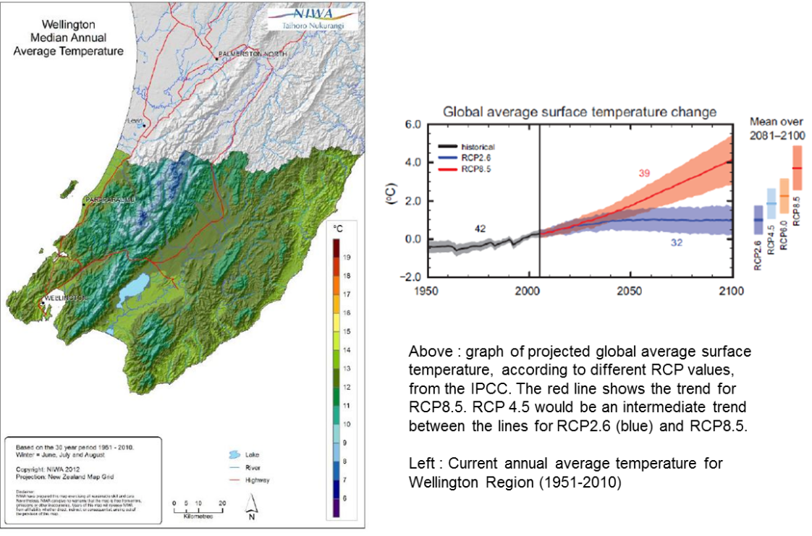
TAS VC and Warming Climate
Since 1980, and until 2025 the Global mean annual temperature for has risen about 1⁰C.
1950-2010 average temperatures for much of the Upper Hutt area were in the 11-12⁰C range
TASVC depends on SFS Class
A drop to SFS class 2 would reduce TAS to either the greater of baseline values or NBL of 0.93m.
Notes:
The SFS classes quoted in the NPSFM (2020) link back to 1950-1980 temperature data
This really needs updated data e.g. from NIWA, but it costs………
The projected global temperature increases date from 15 years ago, and could now be forecasted as worse than shown
I have estimated average temperature changes from the charts available from NIWA, copied here.
Our main submission goes into this in more detail, but we think the SFS classes used in the NPSFM were from the old 1951-1980 data set, and since then there has been about a 1 degree increase in average temperature (Globally)
It is highly probable that several key rivers in the TaOP and TWaT whaitua would change their SFS status if reclassified on current temperature data.
Some of them (Waiwhetu, Hulls creek at Pinehaven, Upper Hutt, Porirua and Taupo Stream were already designated at SFS class 2, so have much lower TASVC than SFS Class 3 rivers.
It is predicted that average temperature will be significantly higher before 2040, which is the target date for several TASVC to be achieved

Slide 8
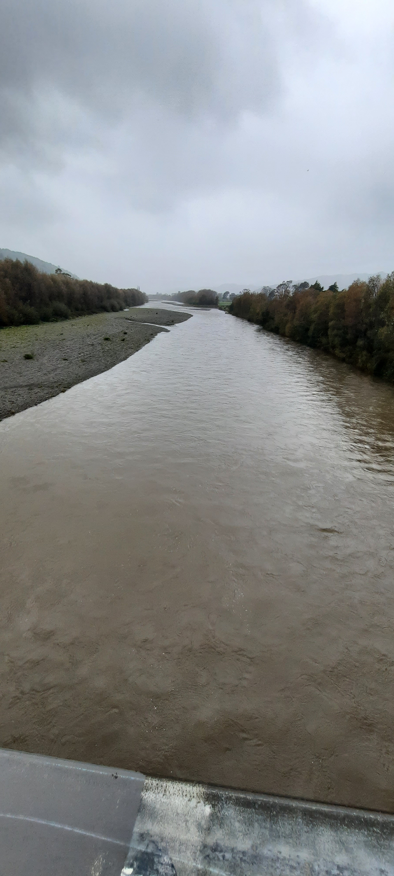
Factors affecting Median VC at Boulcott
Te Awa Kairangi at Kennedy Good Bridge, 2 May 2025
Changes to total annual sediment yield in the wider catchments with uncertain amount of accumulation in lower reaches
Any minor but frequent sources of SFS upstream
Flood control measures (Bulldozing in river bed)
More frequent high flow events
Higher flow rates low in catchment, so increased base flows compared to upstream monitoring sites
Notes:
Reminding you, that the SFS class (and therefore NBL for clarity) is not dependent on position in the catchment, or vegetation cover, or nature of topsoil, but all these do affect VC.
So VC is never going be as good as the forested tributaries
Higher and more frequent flood flows, whilst possibly not affecting the median flow very much, still bring in more sediment that can slowly leak under low flow conditions. That is in part, entirely NATURAL
Higher flow rates low in a catchment, by definition, have more ability to disturb accumulated sediment.
The slide here is looking upstream from Kennedy Good Bridge, near the Boulcott sampling site. The river is in moderate flood. (approx. 74 m³/s)

Slide 9
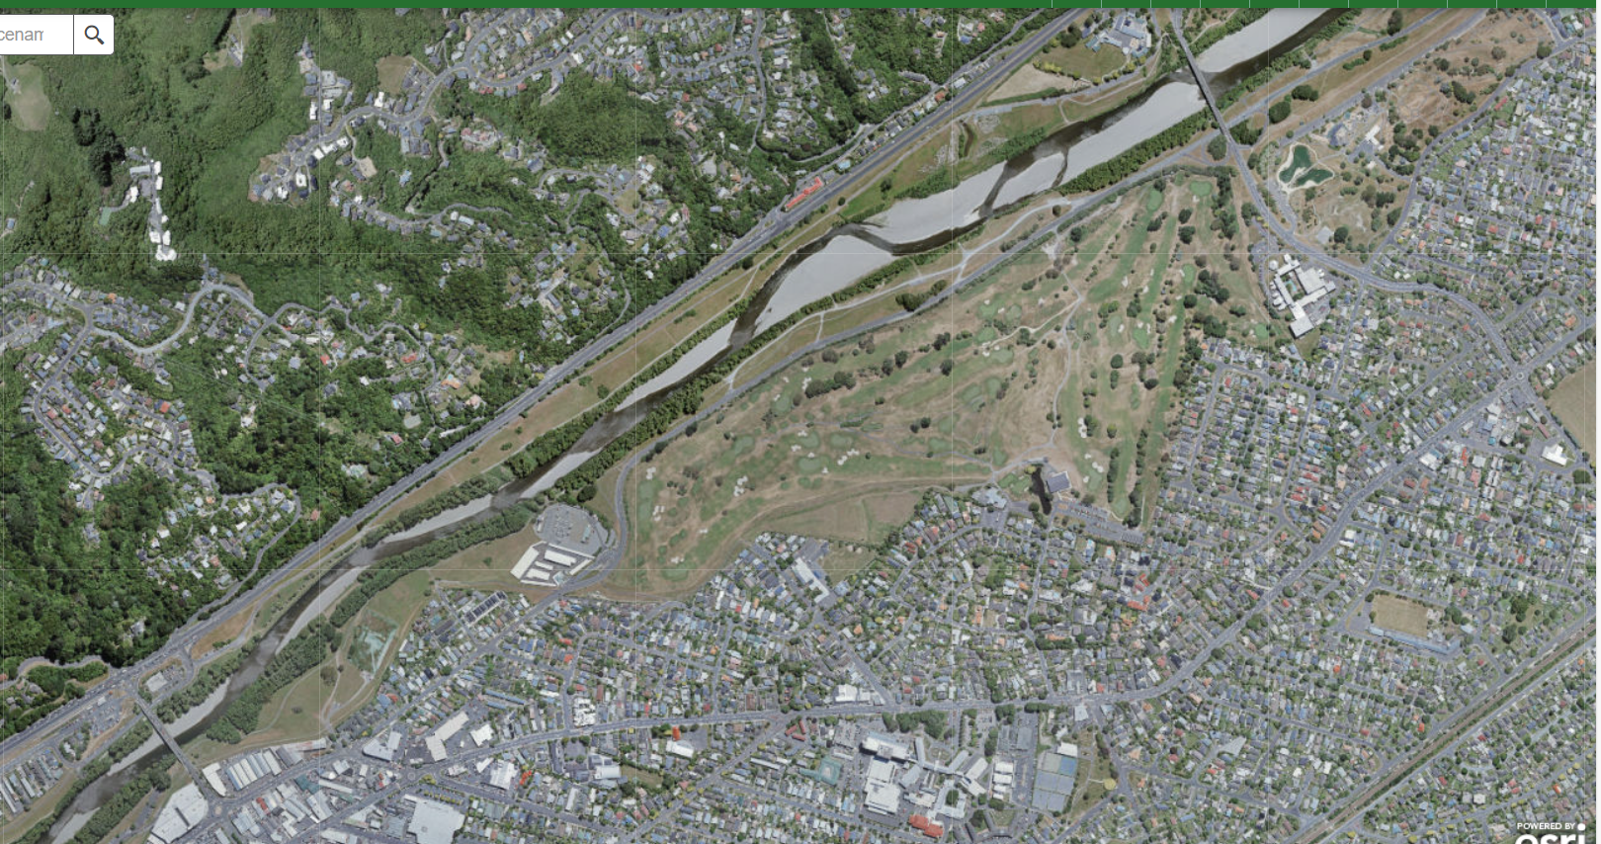
Reset TASVC for Hutt Boulcott
It is very unlikely that Hutt at Boulcott could ever reach SFS Class 3, State A.
The TAS is set too high.
The cost burden and uncertainty of gaining consent for forestry activities is unreasonable
Notes:
Cost burden is costs of either consent or restricted conditional consents, especially for small blocks. It is not clear whether separate consents are required for replanting or afforestation, or how many activities can be rolled into one consent.
If whole cycle forestry consent is sought at planting time, the costs must be amortised until harvest, and it is quite likely that harvesting technology, markets and political climate will have changed over the intervening 30 years.

Slide 10
Summary
First Preference: Insufficient stringency to override NESCF and therefore WH.R20 needs to be amended.
Second Preference: For GW to control forestry only on potentially high risk erosion land in the pFMU where TAS VC is not met
Third Preference: to support Restricted Discretionary Forestry Activity in pFMU where TAS VC is not met
In all scenarios, much improved enforcement of conditions is required, along with education and Water Plans to gather the facts and review TAS settings
Notes:
One by one, the initial arguments that GW has used to justify consented activity for forestry, and therefore the need to override the NESCF, have fallen over.
The erodible land classifications didn’t stack up, so the proposal to retire out forestry harvest from the 10% or more of steepest land has been withdrawn.
Mangaroa River TAS VC was substantially reduced in the face of natural sources of colour, CDOM.
Calculated % reductions in Annual Sediment Load are subject to significant uncertainty, especially concerning meeting median VC at relevant flow rates, so we don’t really know whether proposed land use mitigations will undershoot or overshoot the mark.
Horokiri, Whakatikei, Akatarawa, Pakuratahi still meet TASVC, in spite of many years of forestry harvesting. No one knows how much SFS can be trapped downstream. The 4 rivers mentioned are fairly long, and if slugs of SFS moving downstream were an issue you would think that they would (at least sometimes) show up at the monitoring points. There is no evidence that they do show up.
TASVC for Hutt at Boulcott is under serious challenge as being unreasonable, by not taking into account higher flow rates (position in the catchment), flood control activities and land use changes that are irreversible (ubanisation and farming/forestry).
Whilst all people in the forestry business accept that forestry activities can contribute SFS to water bodies, we believe that improvements in harvesting practises and improving compliance with NESCF is enough for Forestry to do its bit to achieve TASVC, Several major catchments with substantial PF have always managed to comply with TASVC, even with use of older technology.
We say that there is not enough hard evidence to single out forestry, or sufficient magnitude of failed TASVC to warrant overriding NESCF.

Slide 11
Summary, Continued
WH.R20 needs clarification on use of latest data (should be median VC data from at least 5 years time period)
WH.R20 is inconsistent with Policy WH.P28 (and S42A forestry report) regarding receiving water bodies
Need to review TASVC for Hutt at Boulcott, please reduce TASVC to baseline state
Consider, perhaps in water plans, the impact of rise in mean annual temperature on SFS class and subsequent effects on National Bottom Line VC levels (SFS Class 2).

Slide 12
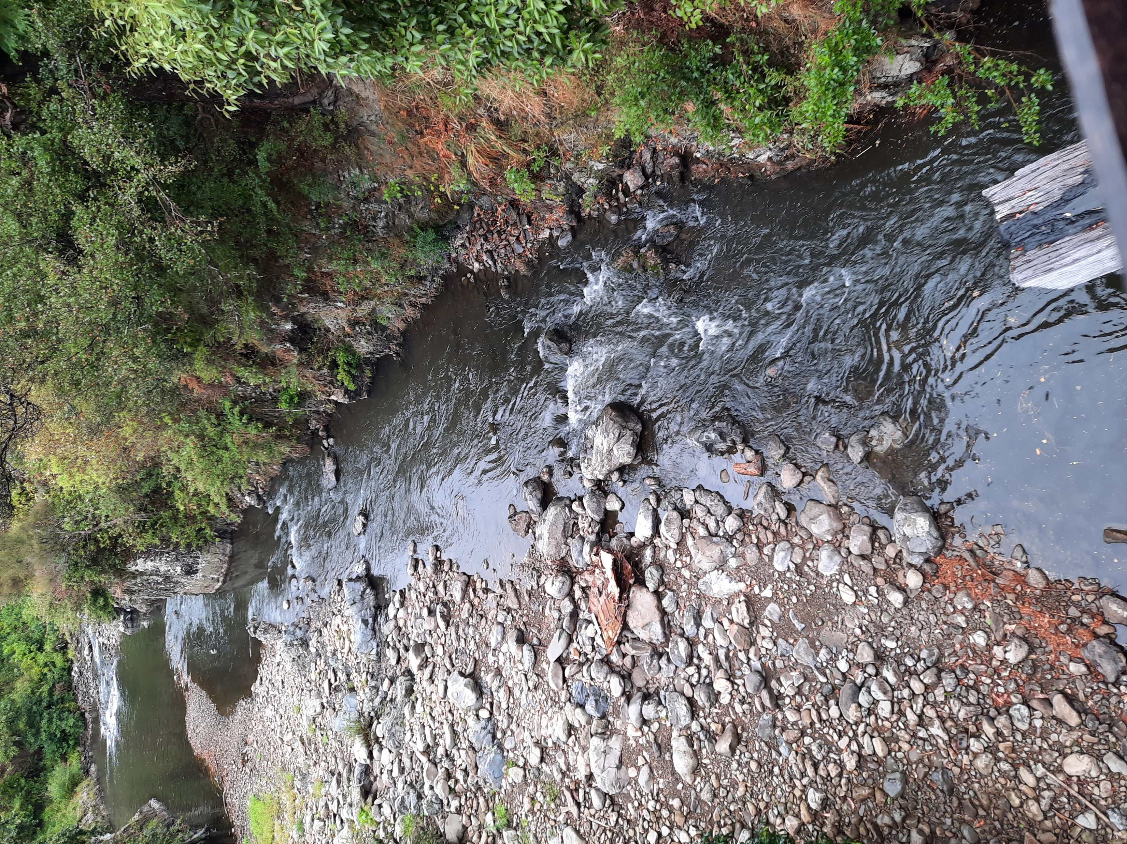
Presentation Ends
Presentation
Ends

