Slide 1

Welcome to Metlink’s Social Story Template
This template has:
A reference slide with helpful links
A blank slide to duplicate and use
An example story to use as is, or edit
Delete this slide when you don’t need it anymore.

Slide 2
Reference slide
Click here to view:
Image library:
Use these photos and icons, or use your own.
Step by step story plan:
Every step to how to catch a bus explained to help you write your story.

Slide 4
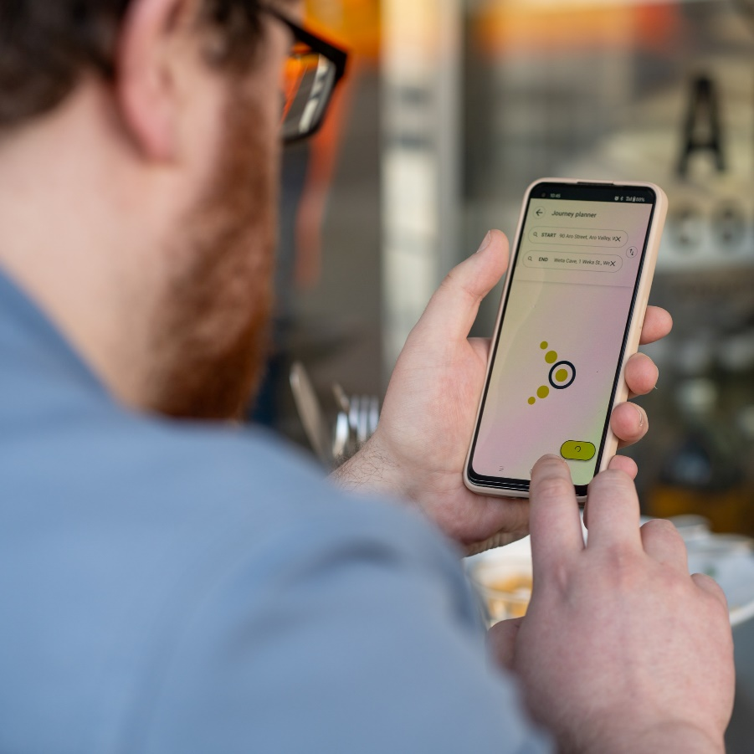

Step 1 - Plan
I have a plan.
I know how my trip is going to go.

Slide 5




Step 2 - Start
I am ready to go to the bus stop.

Slide 6
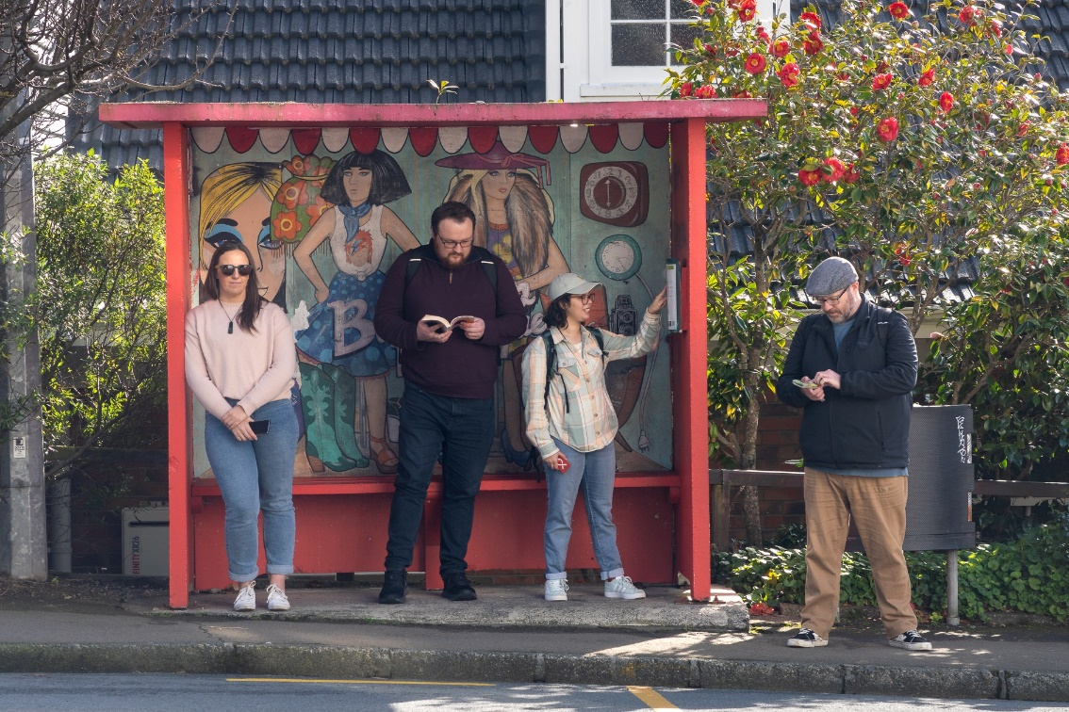
Step 3 - Wait
I wait at the bus stop.

Slide 7
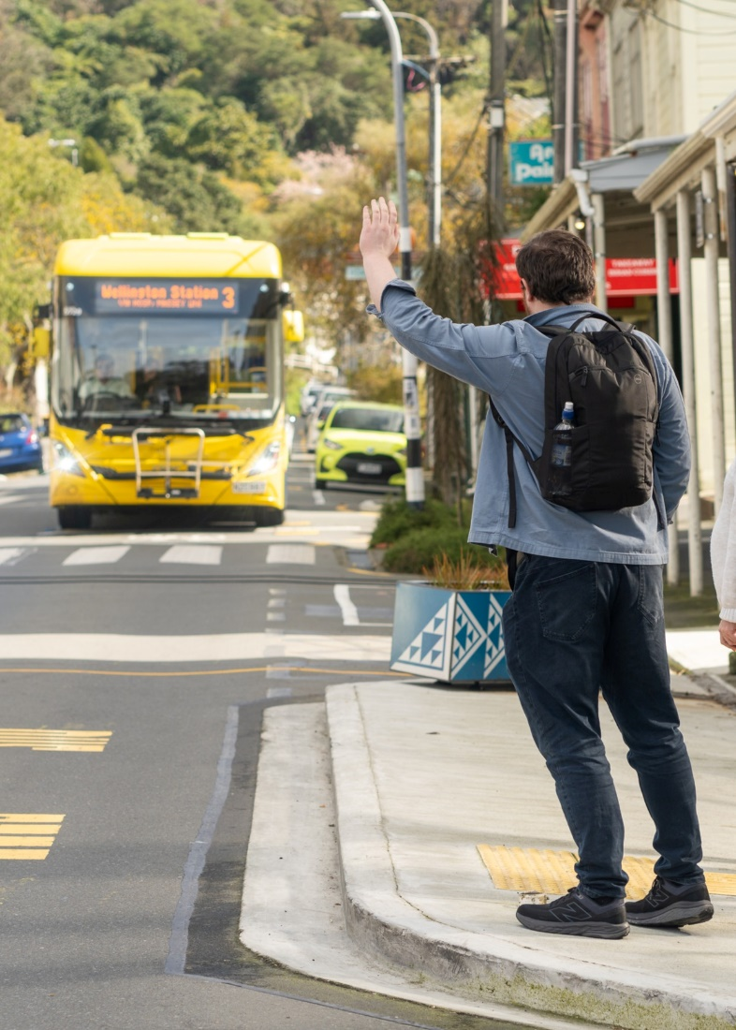

Step 4 - Catch
I wave when I see the bus.
Waving tells the bus driver that I need the bus to stop.

Slide 8
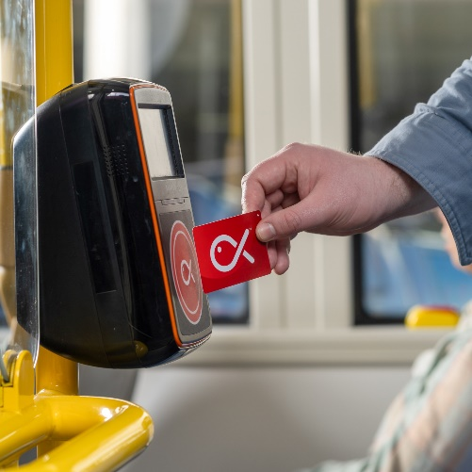

Step 5 - Ride
I tag on with my card.
I sit down if I can.

Slide 9

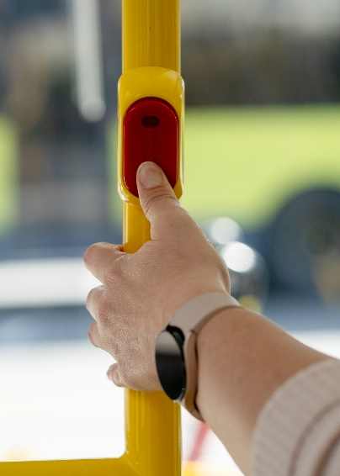
Step 6 - Decide
My stop is next.
I push the stop button.

Slide 10

Step 7 - Exit
I tag off with my card.
I get off the bus.

Slide 11


Step 8 - End
I finish my trip.

